Slide 1



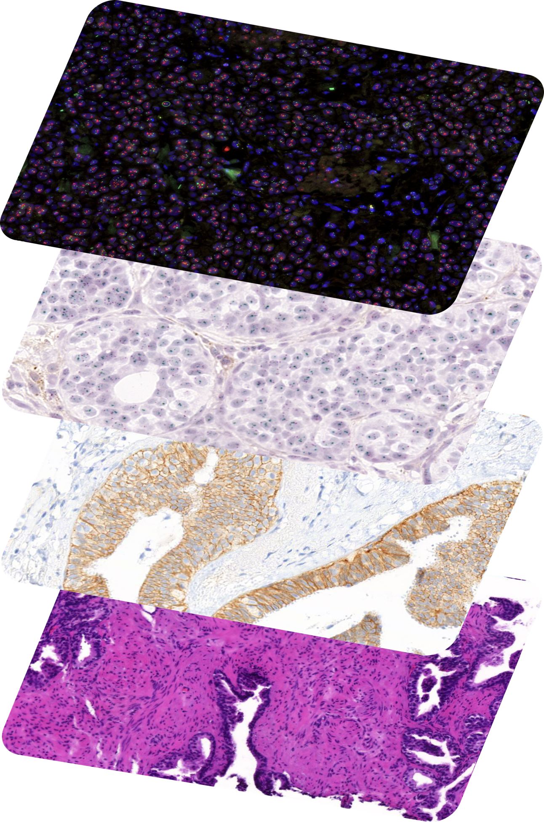
Foundation models in histopathology

Slide 2
Foundation models in histopathology
TOC
What are foundation models?
and is it something new?
Training foundation models
for computer vision tasks
Foundation models in histopathology
open-source open-weights models
Tumor detection with foundation models
training a model based on feature extraction
Comparing foundation models
without a downstream task

Slide 3
What are foundation models?
TOC
Large-scale machine learning models
trained on massive datasets
Transfer learning to the next level
knowledge gained from one task used for another
Self-supervised learning
most foundation models leverage self-supervised learning
Scale and resources
training requires high-throughput multi-GPU infrastructure

Slide 4
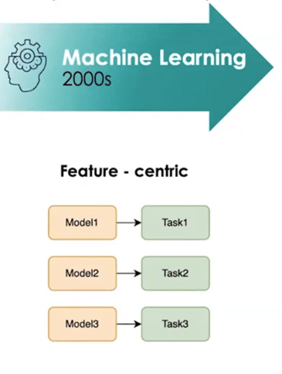
What are foundation models?
TOC
Large-scale machine learning models
trained on massive datasets
Transfer learning to the next level
knowledge gained from one task used for another
Self-supervised learning
most foundation models leverage self-supervised learning
Scale and resources
training requires high-throughput multi-GPU infrastructure

Slide 5
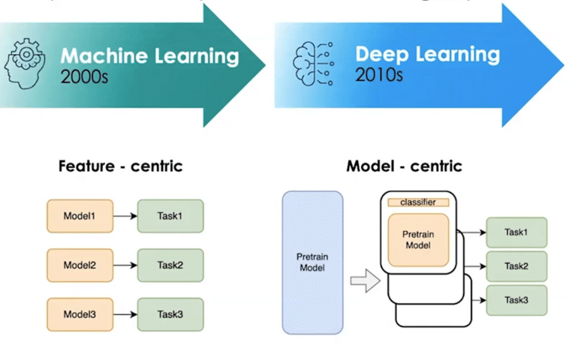
What are foundation models?
TOC
Large-scale machine learning models
trained on massive datasets
Transfer learning to the next level
knowledge gained from one task used for another
Self-supervised learning
most foundation models leverage self-supervised learning
Scale and resources
training requires high-throughput multi-GPU infrastructure

Slide 6
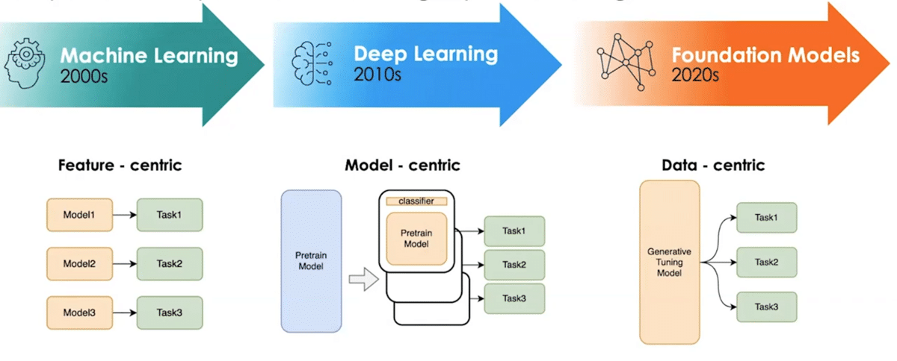
What are foundation models?
TOC
Large-scale machine learning models
trained on massive datasets
Transfer learning to the next level
knowledge gained from one task used for another
Self-supervised learning
most foundation models leverage self-supervised learning
Scale and resources
training requires high-throughput multi-GPU infrastructure

Slide 7
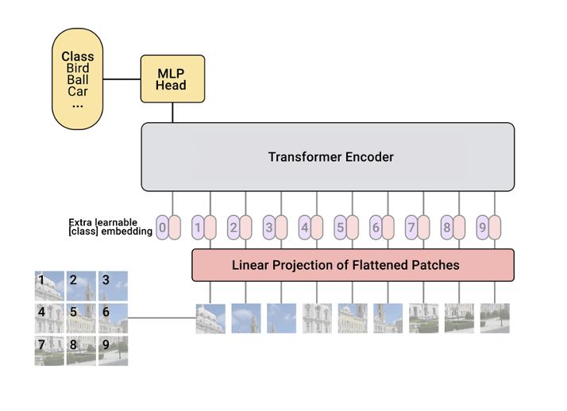
Training foundation models for computer vision
Most FMs are vision transformers
long-range dependencies, self-attention, self-supervised learning

Slide 8

Training foundation models for computer vision
Most FMs are vision transformers
long-range dependencies, self-attention, self-supervised learning
CNNs as feature extractors
trained on ImageNet, without classification head

Slide 9
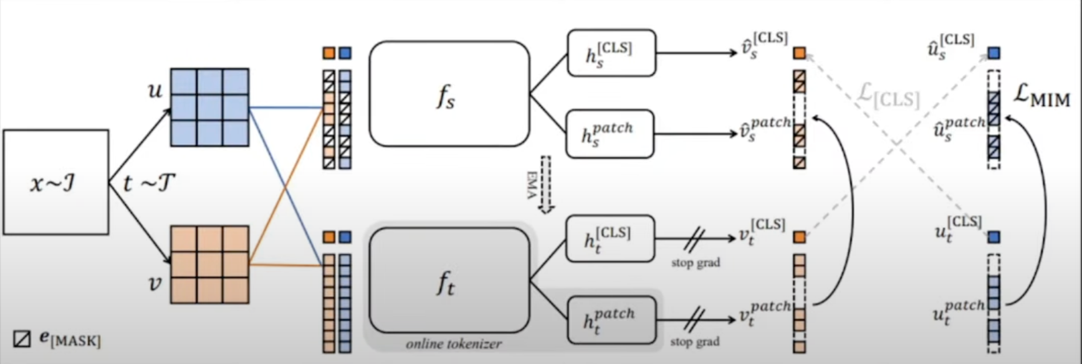
Training foundation models for computer vision
Most FMs are vision transformers
long-range dependencies, self-attention, self-supervised learning
masked
patches
cross-view
token loss
contrastive
views
student
Trained with DinoV2 framework
self-supervised, student-teacher, contrastive learning
teacher
masked image loss

Slide 10
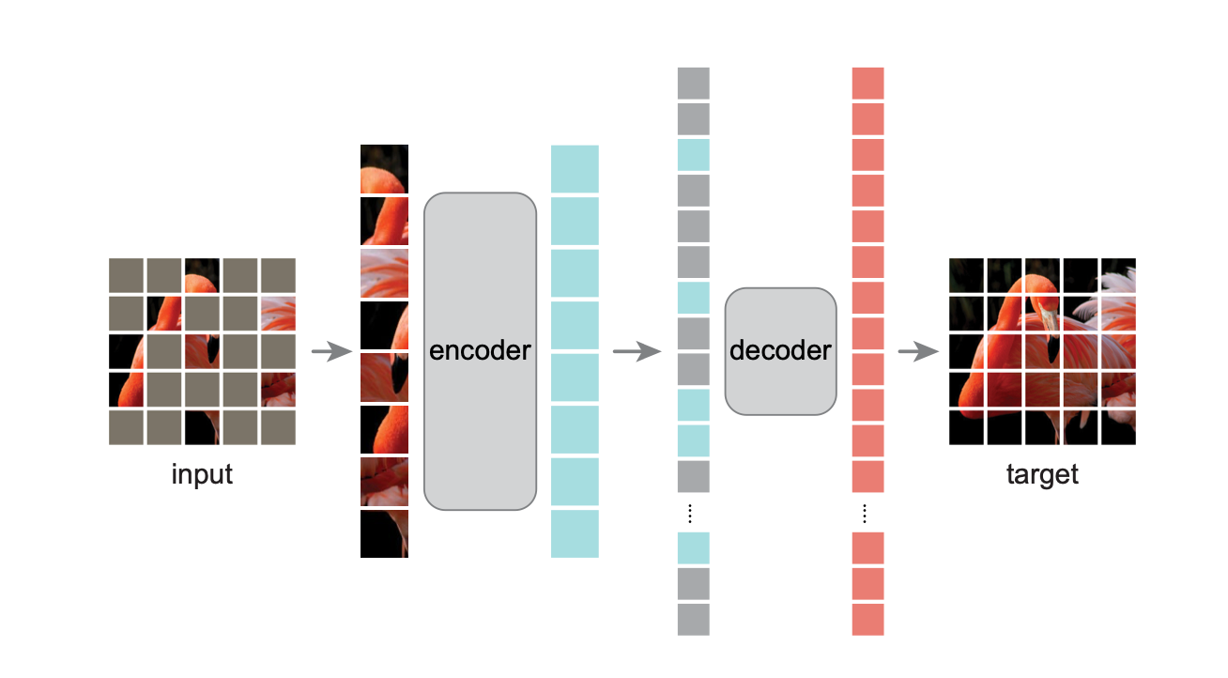
Training foundation models for computer vision
Most FMs are vision transformers
long-range dependencies, self-attention, self-supervised learning
Trained with DinoV2 framework
self-supervised, student-teacher, contrastive learning
Masked image modeling
learning image features by “inpainting” of masked patches

Slide 11
Foundation models for histopathology
H-Optimus-0 Bioptimus
Many foundation models for histopathology
released in 2024, mostly by companies
GigaPath Microsoft
Hibou HistAI
License: Many open-source and open-weights
Some even with permissive license
Phikon Owkin
Virchow Paige
Data: 100k to 1M whole slide images
100M+ image patches
UNI Harvard
KAIKO-1 Kaiko
Architecture: ViT trained with DinoV2
100M+ image patches
PLUTO PathAI
RudolfV Aignostics

Slide 12
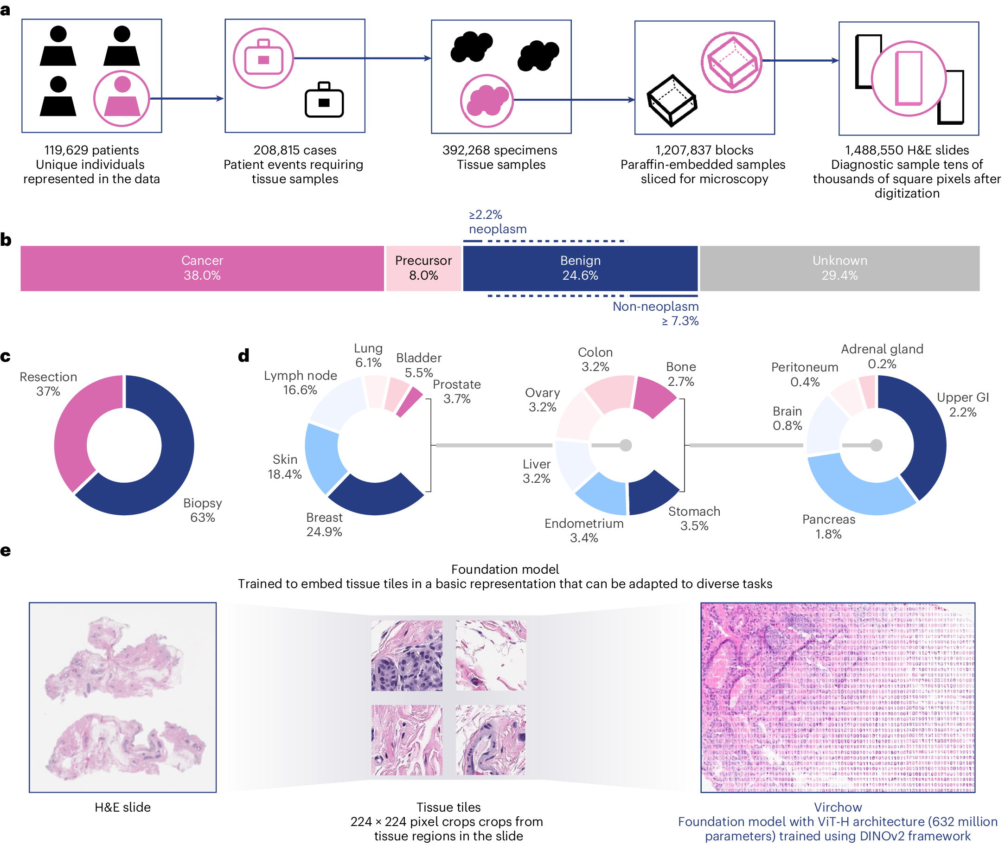
Foundation models for histopathology
Virchow by Paige
largest to date
1.5 million whole slide images
from 120.000 patients
Diversity in specimen types
organs and tissue types
Extract image patches from WSI
and train ViT-H using DinoV2

Slide 13
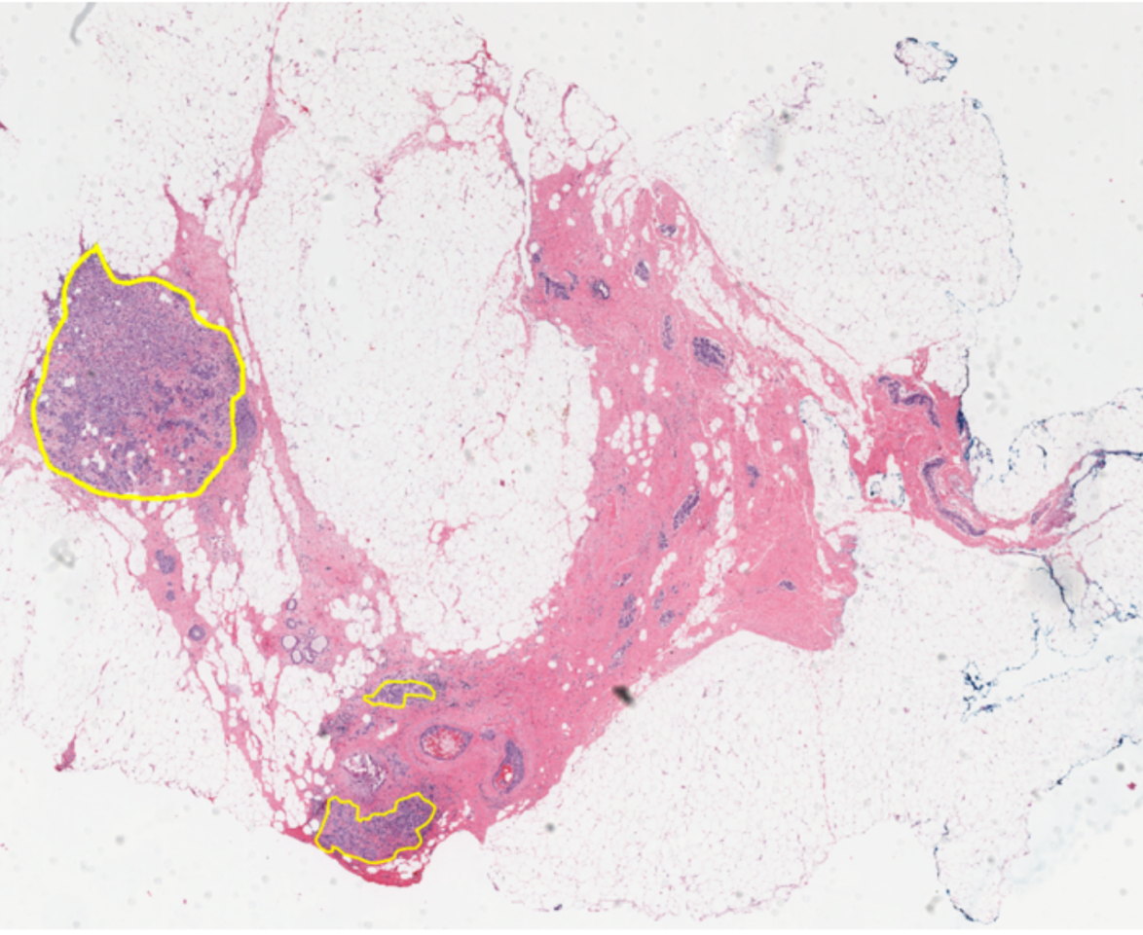
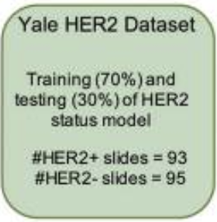
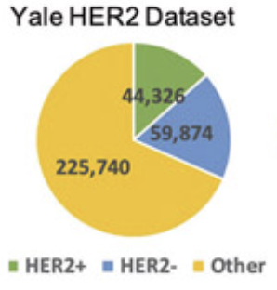
Using foundation models for tumor detection
Train model to detect tumor in H&E stained tissue
based on foundation model
Yale HER2 dataset ~200 whole slide images
with 100 positive and 100 negative cases
Use foundation model for tile embedding
assuming proper feature extractor for H&E images
https://www.cancerimagingarchive.net/collection/her2-tumor-rois/
Train a simple MLP binary classifier
based on tile embeddings

Slide 14
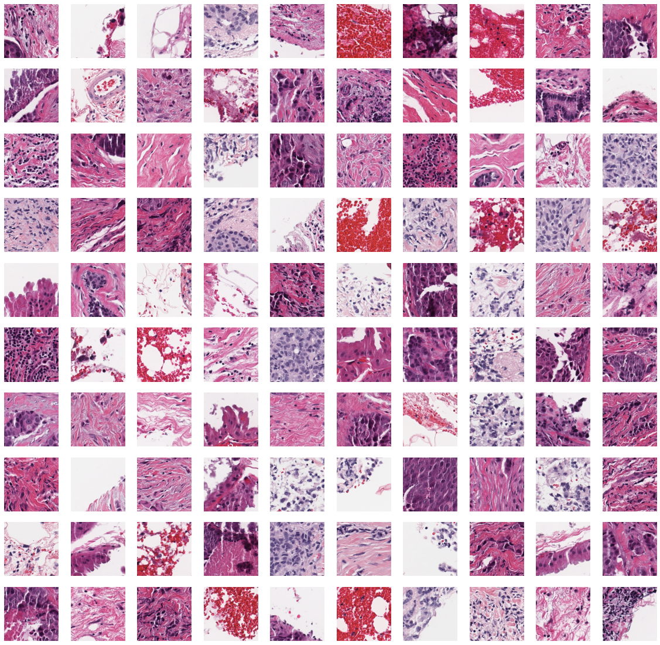
Using foundation models for tumor detection
Take 200 H&E stained whole slide images
large images: approx. 80.000 x 80.000 pixels
Extract 200.000+ 224x224 px image patches
pixels, only from regions containing tissue
Convert polygon annotations
to yield patch label (tumor: yes/no)
Feature extraction using foundation models
in this case GigaPath, UNI and H-Optimus-0
Grouped data splitting based on WSI
to avoid data leakage between patches from same WSI

Slide 15
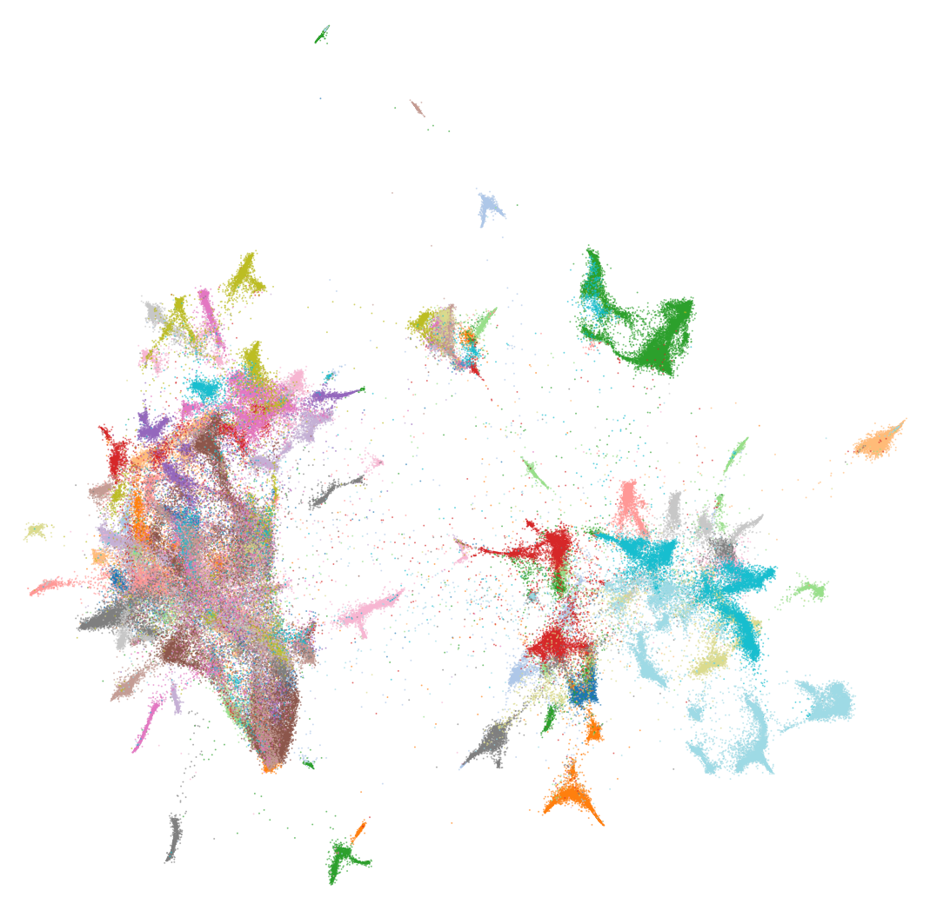
Using foundation models for tumor detection
Sneak peak in tile embeddings
UMAP of H-optimus-0 embeddings, color-coded by WSI
Noticeable clustering of embeddings by WSI
may be batch effect, but could be harmless if not used by classifier

Slide 16
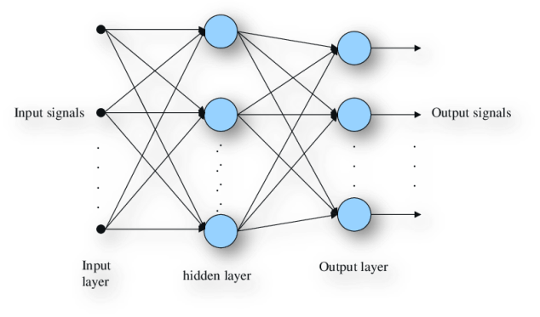
Using foundation models for tumor detection
Train a simple two-layer MLP classifier
with binary cross-entropy -- within a minute
tile embedding
tumor probability

Slide 17
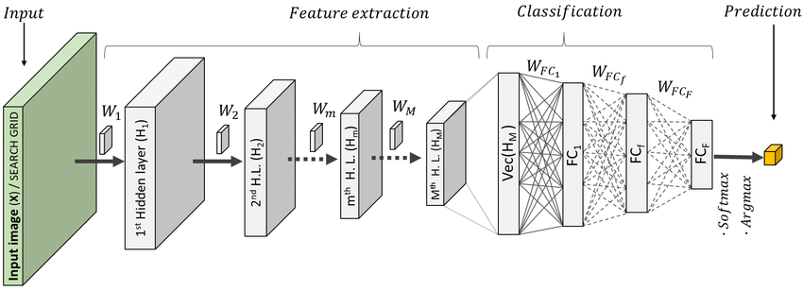
Using foundation models for tumor detection
Train a simple two-layer MLP classifier
with binary cross-entropy -- within a minute
Using foundation model as classic feature extractor
just like what we used to do with pretrained CNNs

Slide 18
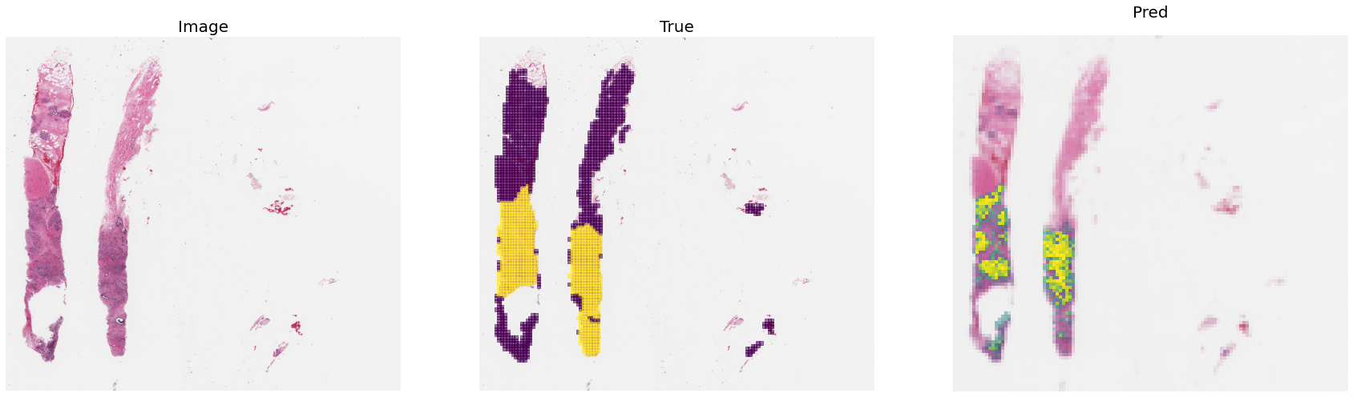
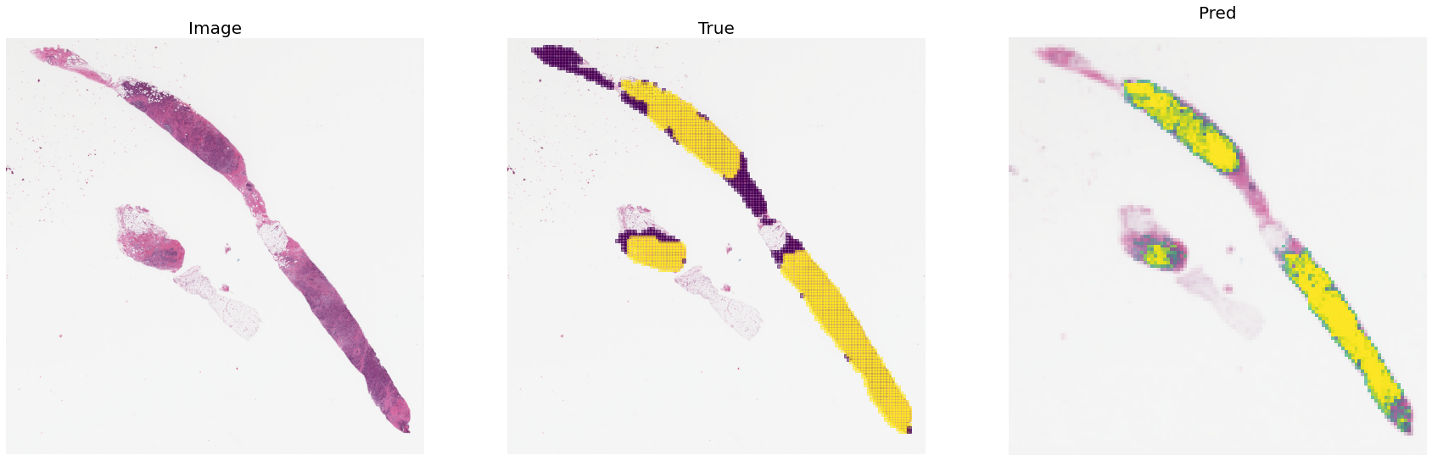
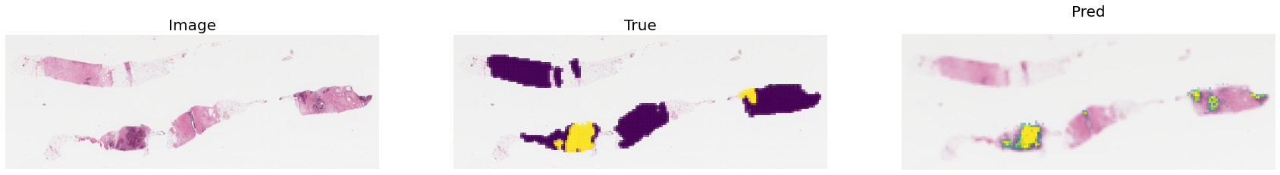
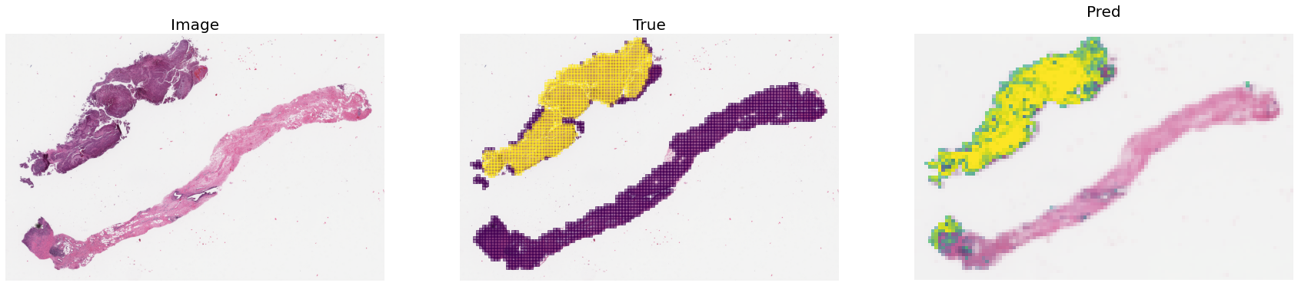
Using foundation models for tumor detection
Train a simple two-layer MLP classifier
with binary cross-entropy -- within a minute
Using foundation model as classic feature extractor
just like what we used to do with pretrained CNNs
Inference on whole slide image
tile image, embed patches, predict labels, re-assemble
Results look promising
although quantitative evaluation is pending
Currently training prostate cancer grading
using own dataset for Gleason grading

Slide 19
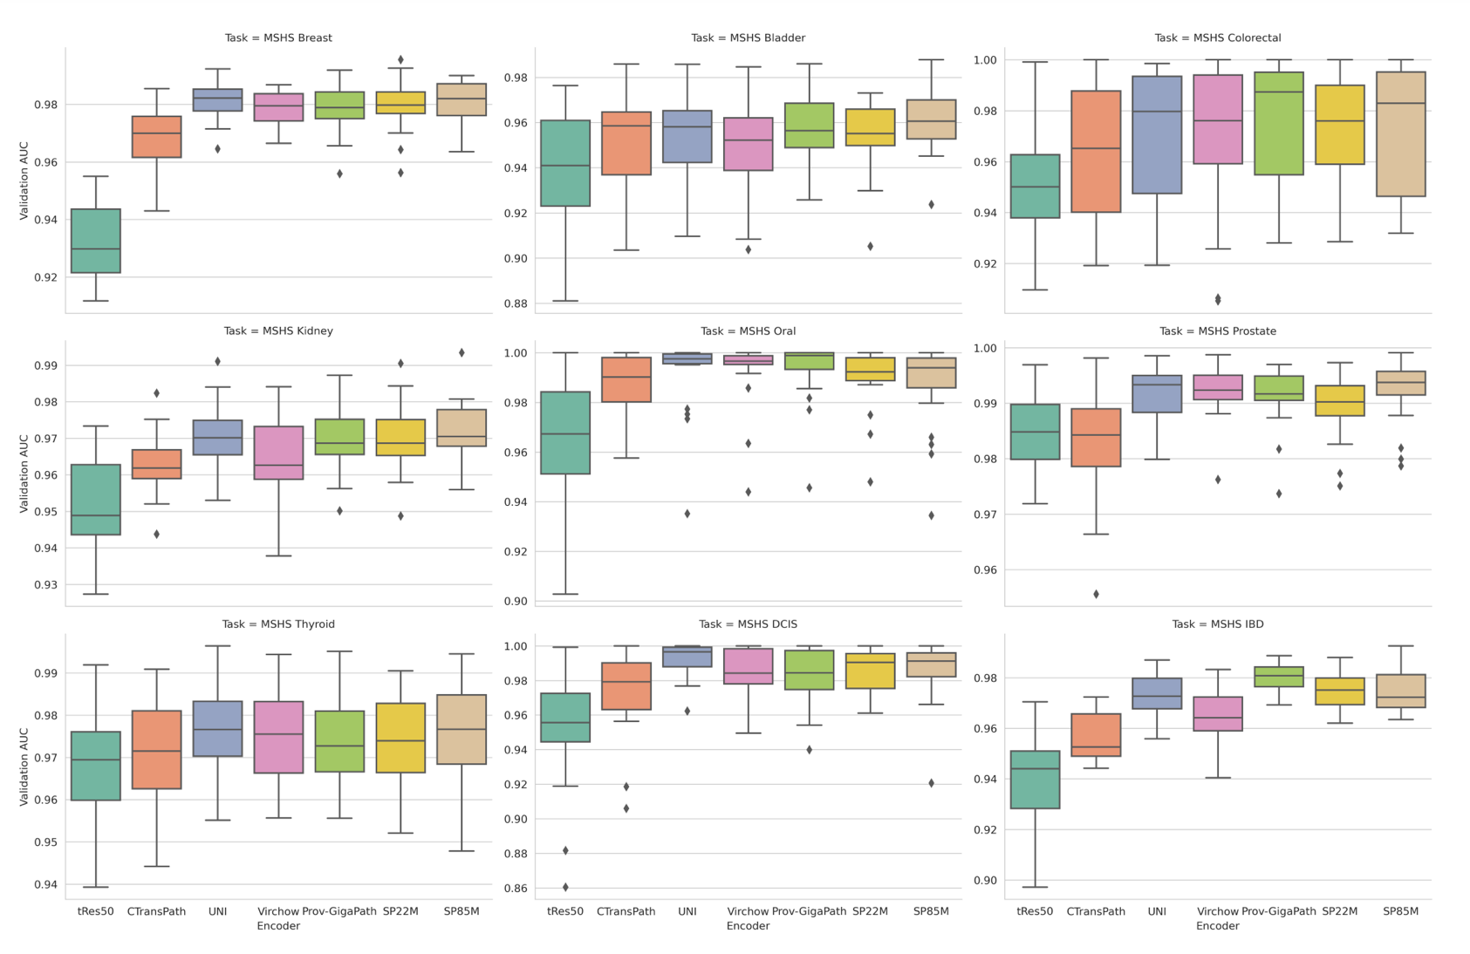
Comparing models without downstream task
Comparing foundation models
important to select which model to take for a task
Typically done by evaluating against multiple benchmarks
and evaluate the best-performing model across tasks
But can we compare models without downstream task?
e.g. to discover similarities and differences in embeddings
https://arxiv.org/pdf/2407.06508

Slide 20
Comparing models without downstream task
Take a large dataset of patches same 200k patches as before
Compute tile embeddings using multiple foundation models

Slide 21
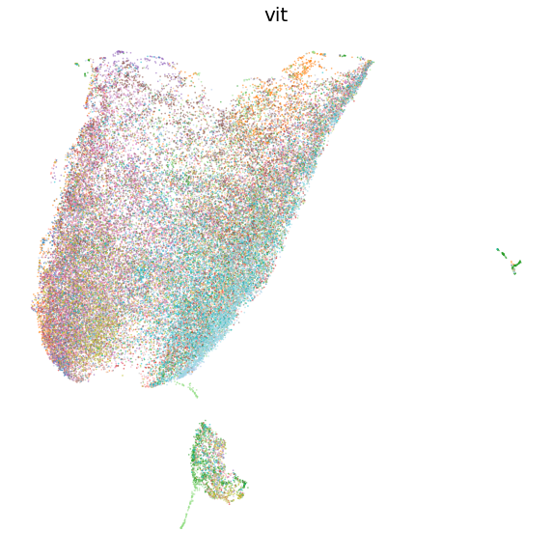
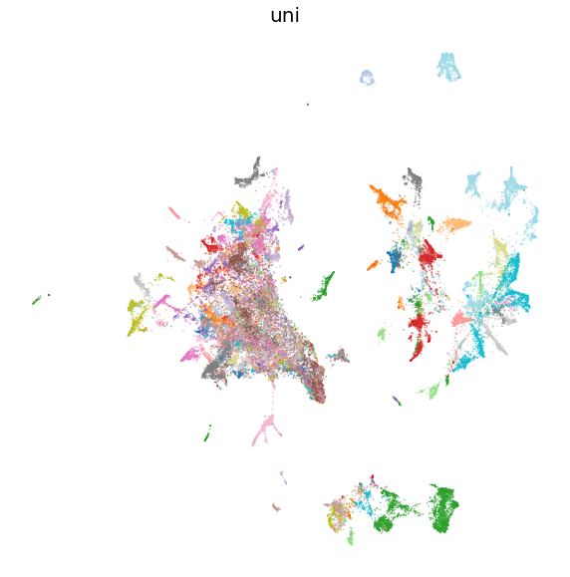
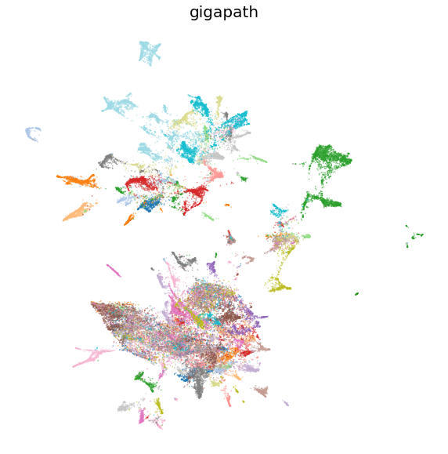
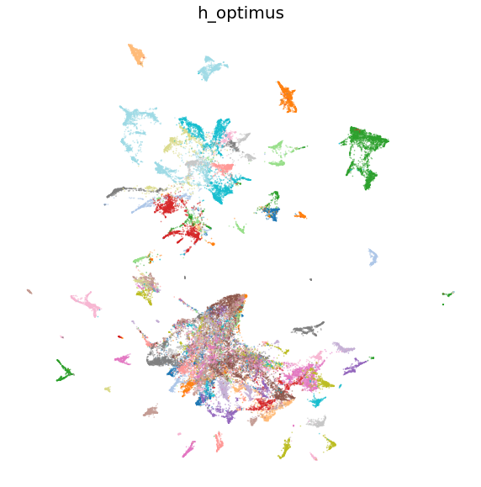
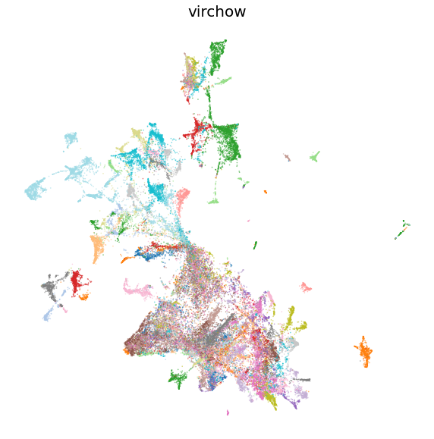
Comparing models without downstream task
Take a large dataset of patches same 200k patches as before
Compute tile embeddings using multiple foundation models

Slide 22
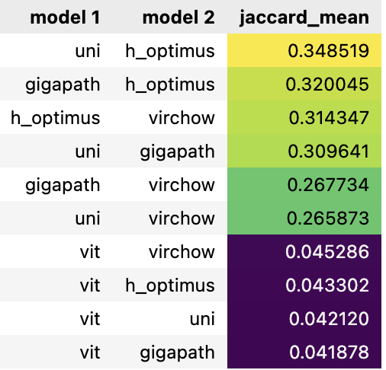
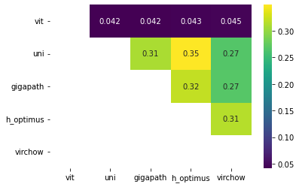
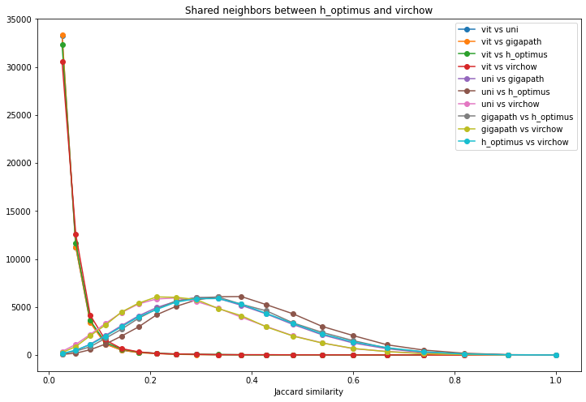
Comparing models without downstream task
Take a large dataset of patches same 200k patches as before
Compute tile embeddings using multiple foundation models
Compare all neighborhoods between all embeddings
Quantify neighborhood similarity to get sense of differences between models

Slide 23
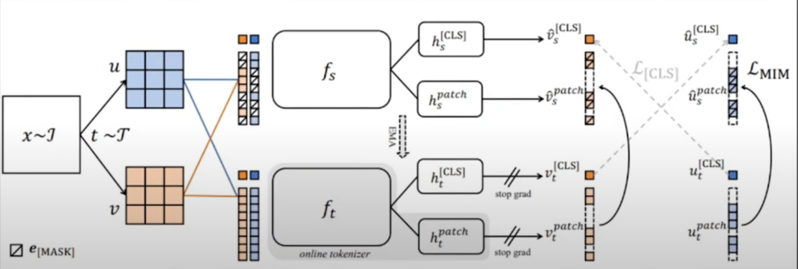
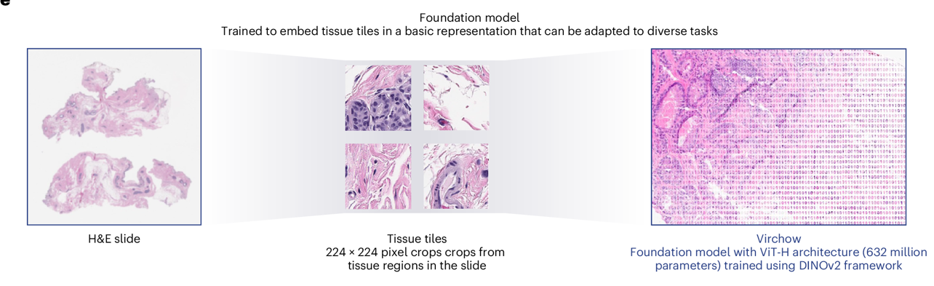
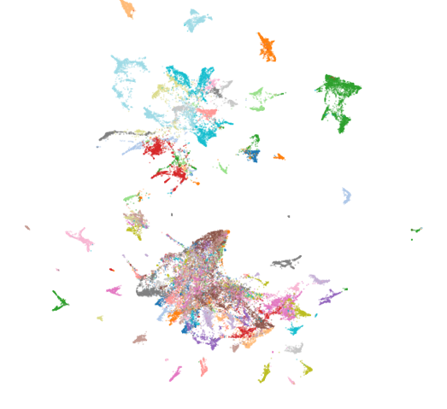
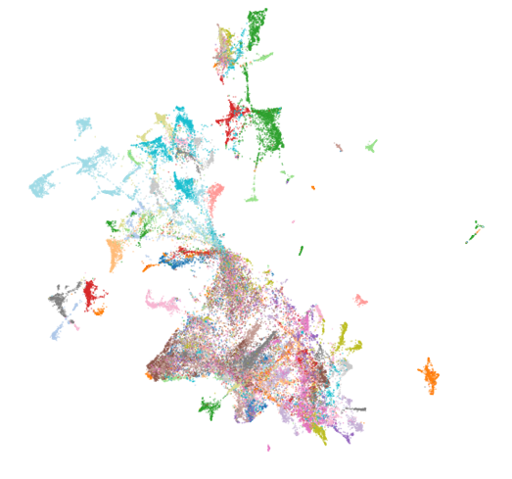
Foundation models in histopathology
TOC
What are foundation models?
and is it something new?
Training foundation models
for computer vision tasks
Foundation models in histopathology
open-source open-weights models
Tumor detection with foundation models
training a model based on feature extraction
Comparing foundation models
without a downstream task

Slide 24
Foundation models in histopathology
Confidential

